Slide 1
DEEP LEARNING ASSIGNMENT
CIFAR-10 DATASET
(IMAGE RECOGNITION)
Apostolopoulos Dimitrios –2022202304004
Iliopoulos Dimitrios – 2022202304008

Slide 2
Agenda
Introduction
Types of models used
Results
Justification of the Models finally used

Slide 3

INTRODUCTION

Slide 4
CIFAR-10 DATASET
The CIFAR-10 dataset is a benchmark dataset for image classification, created by Alex Krizhevsky, Vinod Nair, and Geoffrey Hinton, first introduced in 2009 in the technical report "Learning Multiple Layers of Features from Tiny Images.“
60,000 color images, each 32x32 pixels, small size enables efficient computation and quick experimentation.

Slide 5
CIFAR-10 DATASET
Ten classes representing everyday objects and animals: Airplane, Automobile, Bird, Cat, Deer, Dog, Frog, Horse, Ship, Truck.
50,000 training images, 10,000 testing images.
Standard benchmark for evaluating image classification algorithms.
Used for experimenting with new techniques like CNNs, data augmentation, and transfer learning.
Popular for teaching and learning machine learning and computer vision due to its simplicity and extensive documentation.

Slide 6
TYPES OF MODELS USED

Slide 7
TYPES OF MODELS USED
CNN (Simple and Complex)
MLP
Transfer Learning

Slide 8
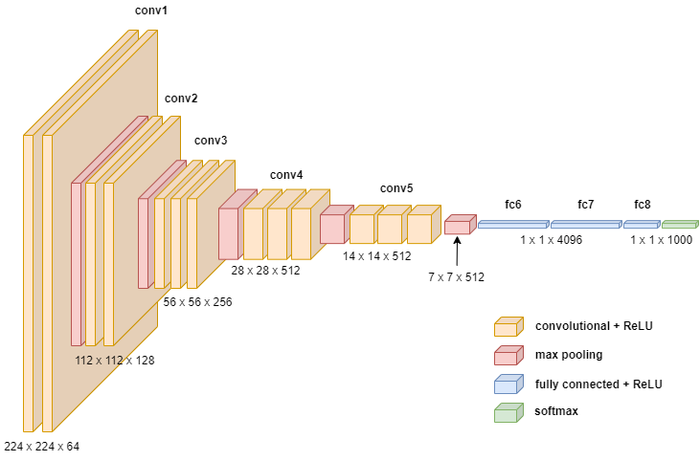
Convolutional Neural Networks (CNNs)
CNNs are deep learning models designed for image and video recognition.
Key Components
Convolutional Layers: Extract features using filters.
Pooling Layers: Reduce dimensionality and computation.
Fully Connected Layers: Perform final classification.
Features
Local Connectivity: Connects neurons to small regions.
Weight Sharing: Reduces parameter count.
Activation Functions: Often ReLU.

Slide 9
Multilayer Perceptrons (MLPs)
MLPs are feedforward neural networks with multiple layers of neurons.
Architecture
Input Layer: Represents input features.
Hidden Layers: Multiple layers with neurons applying weights and activation functions.
Output Layer: Produces predictions.
Features
Fully Connected: Each neuron connects to every neuron in the next layer.
Activation Functions: Commonly use Sigmoid, Tanh, ReLU.
Simpler Structure: Suitable for a wide range of tasks with structured data.

Slide 10
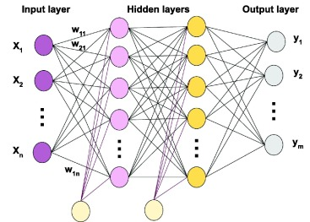
Multilayer Perceptrons (MLPs)

Slide 11
Transfer Learning
Using a pre-trained model on a new task.
Process
Pre-trained Model: Start with a model trained on a large dataset (e.g., ImageNet).
Fine-Tuning: Adjust weights for the new task.
Feature Extraction: Use features from the pre-trained model.
Benefits
Efficiency: Reduces training time.
Performance: Enhances results with limited data.
Versatility: Useful for various domains.
Transfer Learning

Slide 12
RESULTS

Slide 13
Simple CNN
Data Preparation
Convert labels to one-hot encoding.
Split data into training and validation sets.
Apply data augmentation (rotation, width/height shift, horizontal flip).
Model Architecture:
CNN with 3 convolutional layers and max-pooling.
Flatten layer followed by 2 dense layers.
Compile with Adam optimizer and metrics (accuracy, precision, recall, AUC).
Training and Evaluation:
Train model with augmented data. Evaluate model on test set, print metrics (accuracy, precision, recall, AUC, F1 score).
Callbacks: Early stopping, model checkpointing, and learning rate reduction.
Evaluate model performance on test set.

Slide 14
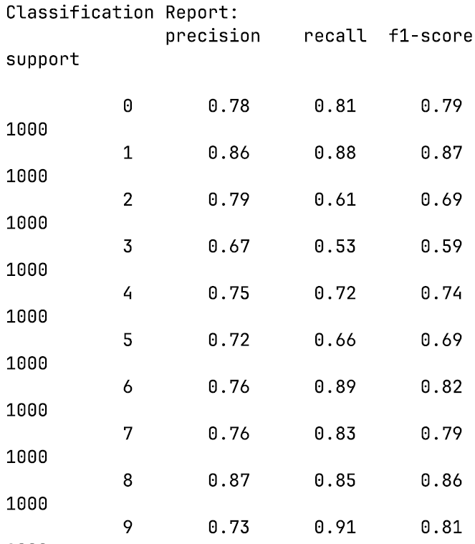
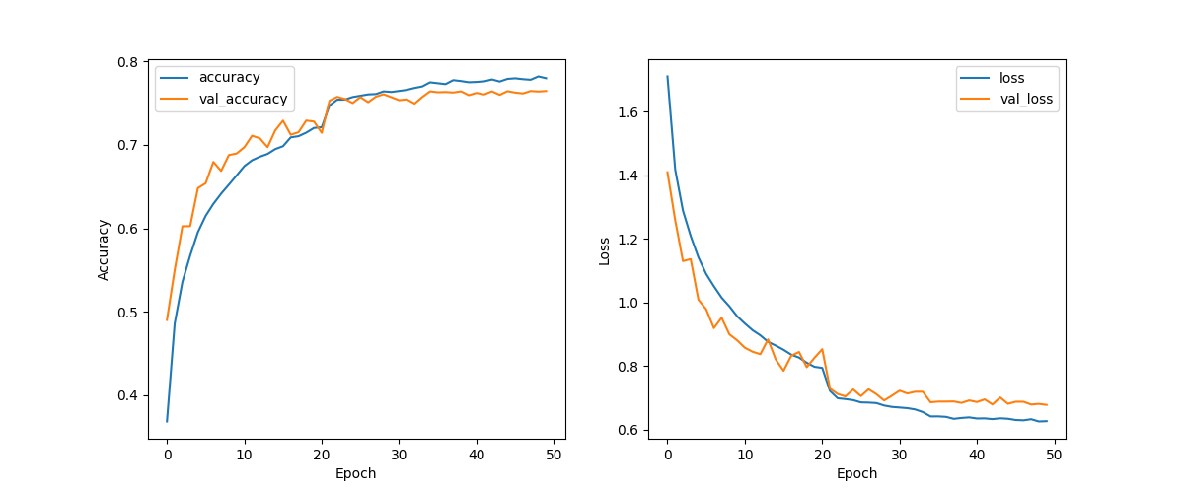
RESULTS – SIMPLE CNN
Test Accuracy: 0.77
Test Precision: 0.82
Test Recall: 0.72
Test AUC: 0.97
Test F1 Score: 0.77

Slide 15
RESULTS – COMPLEX CNN
Data Preprocessing
Normalization: Scale the pixel values to the range [0, 1] by dividing by 255.
One-Hot Encoding: Convert class labels to one-hot encoded vectors using to_categorical.
Model Architecture
Layers: Conv2D: 32 filters, (3x3) kernel, ReLU activation, Conv2D: 32 filters, (3x3) kernel, ReLU activation, MaxPooling2D: (2x2) pool size, Conv2D: 64 filters, (3x3) kernel, ReLU activation, Conv2D: 64 filters, (3x3) kernel, ReLU activation, MaxPooling2D: (2x2) pool size, Conv2D: 128 filters, (3x3) kernel, ReLU activation, Conv2D: 128 filters, (3x3) kernel, ReLU activation, Flatten: Flatten the input, Dense: 128 units, ReLU activation, Dense: 64 units, ReLU activation, Dense: 10 units, softmax activation

Slide 16
RESULTS – COMPLEX CNN
Training and Evaluation
Training: 5-Fold Cross Validation, 20 epochs each fold.
Metrics: Accuracy, Precision, Recall, AUC, F1 Score, Classification Report, Confusion Matrix.
Evaluation Results
Metrics: Test accuracy, precision, recall, AUC, F1 score.
Visualization: Classification report and confusion matrix.

Slide 17
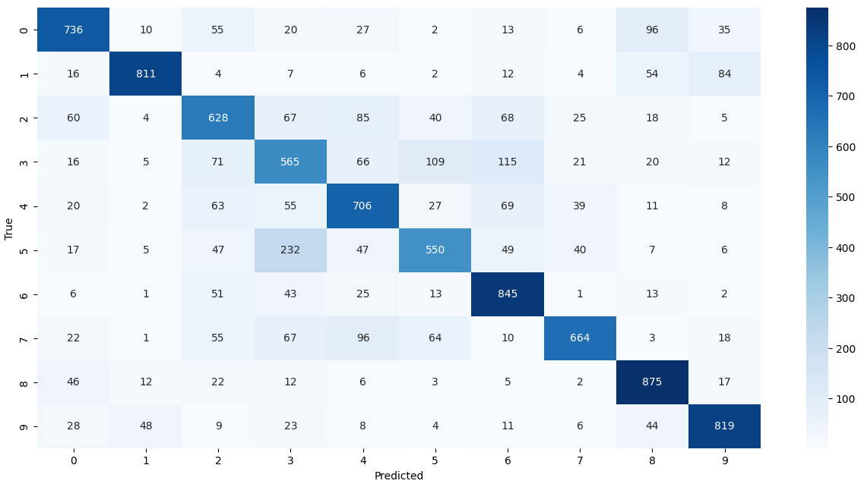
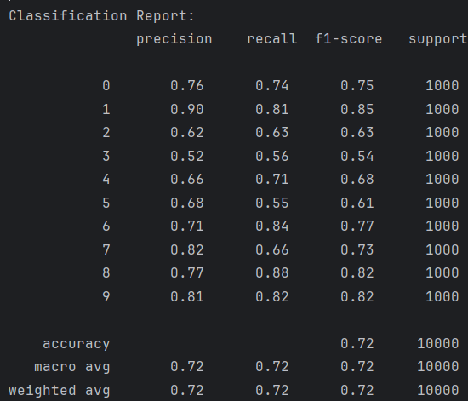
RESULTS – COMPLEX CNN
Test Accuracy 0.72
Test Precision 0.74
Test Recall 0.71
Test AUC 0.93
Test F1 score 0.72

Slide 18
MLP
Data Preparation
Normalize images and convert labels to one-hot encoding.
Flatten images for MLP input.
Split data into training and validation sets (80% training, 20% validation).
Model Architecture:
Sequential model with three dense layers (512, 256, 128 units) and ReLU activation.
Output layer with 10 units and softmax activation.
Compile model with Adam optimizer and metrics (accuracy, precision, recall, AUC).
Training and Evaluation:
Train model on training set, validate on validation set (10 epochs).
Evaluate model on test set, print metrics (accuracy, precision, recall, AUC, F1 score).

Slide 19
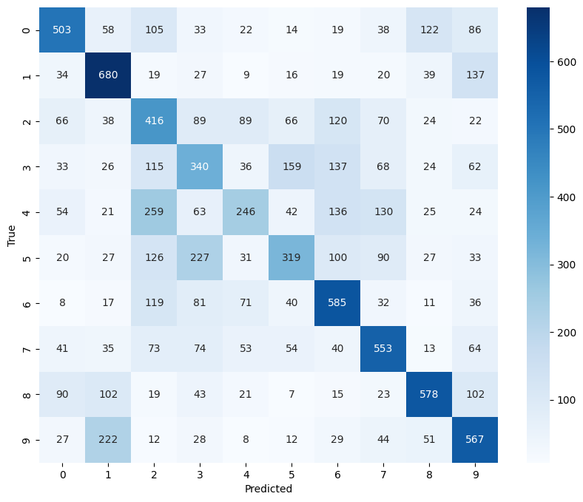
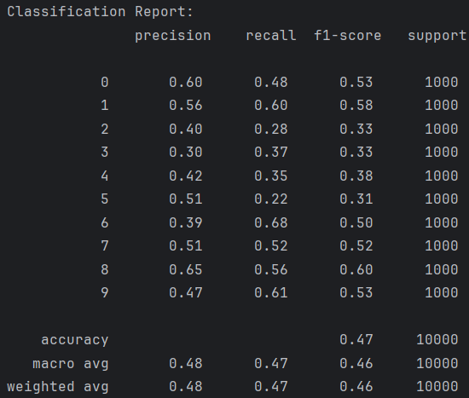
RESULTS – mlp
Test Accuracy: 0.47
Test Precision: 0.68
Test Recall: 0.28
Test AUC: 0.87
Test F1 score: 0.39

Slide 20
RESULTS – TRANSFER LEARNING – VGG16
Data Preparation
The images are normalized by scaling the pixel values to the range [0, 1].
Labels are converted to one-hot encoded vectors.
The training images are augmented with random rotations, width and height shifts, and horizontal flips to improve model generalization.
Model Architecture & Training
VGG16 pretrained on ImageNet, with the top layers removed.
Flatten layer followed by two dense layers (256 and 128 units) with ReLU activation, and a final dense layer with softmax activation for classification into 10 classes.
The model is compiled with Adam optimizer and trained using 5-fold cross-validation. Early stopping and learning rate reduction on plateau are used to improve training efficiency.

Slide 21
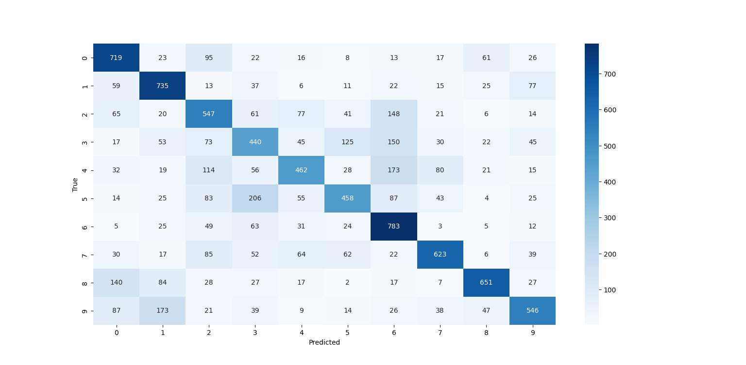
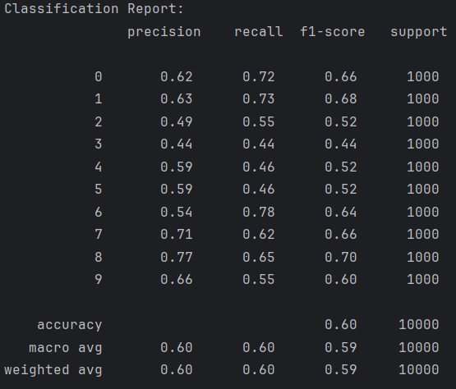
RESULTS – TRANSFER LEARNING - vgg16
Test Accuracy: 0.60
Test Precision: 0.71
Test Recall: 0.49
Test AUC: 0.93
Test F1 score: 0.58

Slide 22
Transfer learning vgg16 with finetuning
Data Preparation
Convert labels to one-hot encoding.
Apply data augmentation (rotation, width/height shift, horizontal flip).
Model Architecture:
Base Model: VGG16 pretrained on ImageNet, excluding top layers.
Additional Layers: Flatten, Dense layers (256, 128 units), and output layer (10 units).
Compilation: Adam optimizer and metrics (accuracy, precision, recall, AUC).
Training and Evaluation:
Initial Training: Train model with frozen base model layers.
Callbacks: Early stopping, model checkpointing, learning rate reduction.
Fine-Tuning: Unfreeze top layers of the base model and re-train with lower learning rate.
Evaluation: Evaluate on test set, plot training history, display classification report, and confusion matrix.

Slide 23
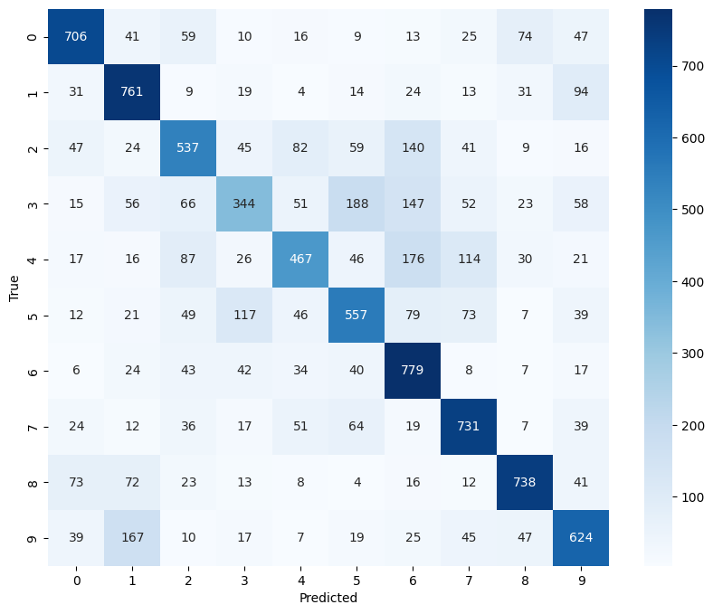
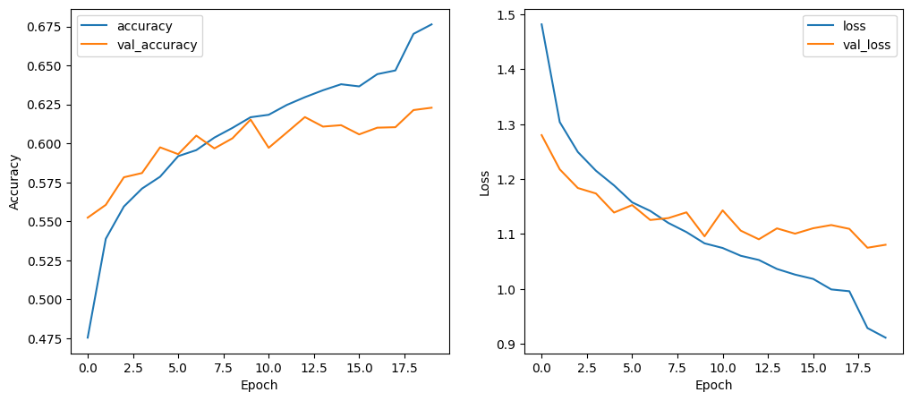
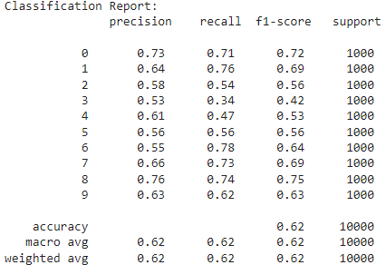
Results – transfer learning vgg16 with finetuning
Test Accuracy: 0.62
Test Precision: 0.71
Test Recall: 0.53
Test AUC: 0.93
Test F1 score: 0.61

Slide 24
Transfer learning restnet50
Data Preparation
Convert labels to one-hot encoding.
Apply data augmentation (rotation, width/height shift, horizontal flip).
Model Architecture:
Base Model: ResNet50 pretrained on ImageNet, excluding top layers.
Additional Layers: Global average pooling, Dense layers (256, 128 units), and output layer (10 units).
Compilation: Adam optimizer, categorical cross-entropy loss, and metrics (accuracy, precision, recall, AUC).
Training and Evaluation:
Initial Training: Train model with frozen base model layers.
Callbacks: Early stopping, model checkpointing, learning rate reduction.
Fine-Tuning: Unfreeze top layers of the base model and re-train with lower learning rate.
Evaluation: Evaluate on test set, plot training history, display classification report, and confusion matrix.

Slide 25
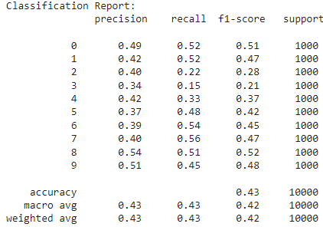
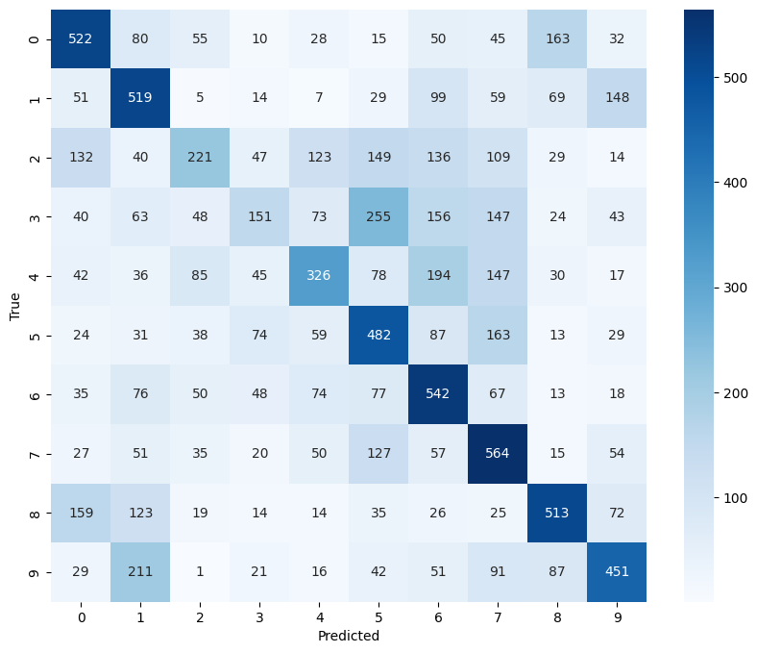
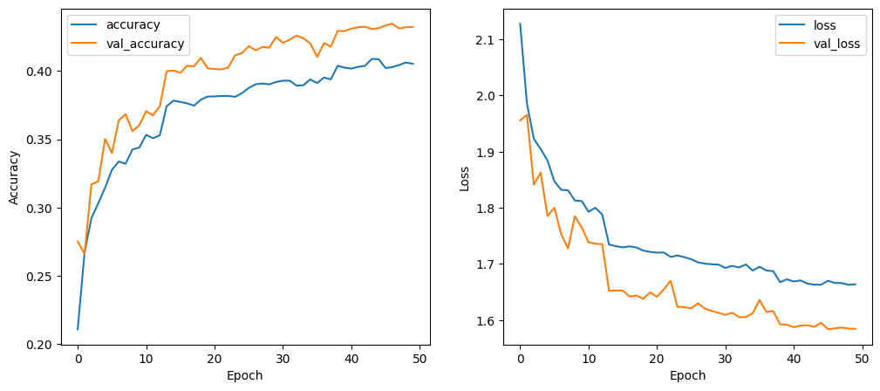
Results – transfer learning restnet50(1)
Test Accuracy: 0.21 → 0.42
Val Accuracy: 0.27 → 0.43
Test Precision: 0.65
Test Recall: 0.17
Test AUC: 0.87
Test F1 score: 0.28

Slide 26
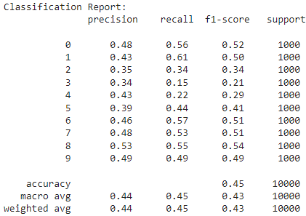
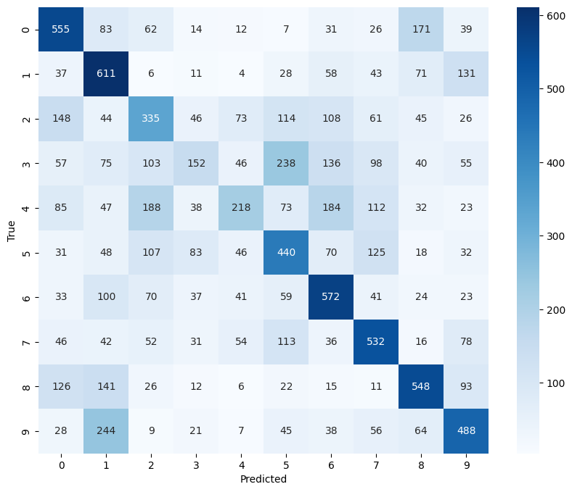
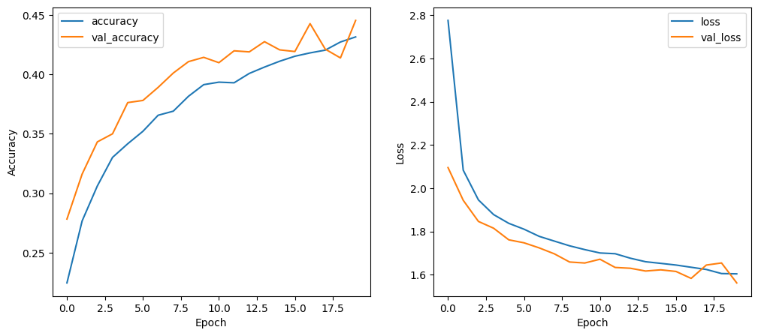
Results - Transfer learning restnet50(2)
Test Accuracy: 0.22 → 0.445
Val Accuracy: 0.27 → 0.445
Precision: 0.65
Test Recall: 0.22
Test AUC: 0.85
Test F1 score: 0.33

Slide 27
transfer learning mobilenetv2
Data Preparation
Convert labels to one-hot encoding.
Data augmentation: Rotation, width/height shift, horizontal flip.
Model Architecture:
Base Model: MobileNetV2 pretrained on ImageNet, excluding top layers.
Additional Layers: Global average pooling, Dense layers (256, 128 units), and output layer (10 units).
Compilation: Adam optimizer, categorical cross-entropy loss, and metrics (accuracy, precision, recall, AUC).
Training and Evaluation:
Initial Training: Train model with frozen base model layers.
Callbacks: Early stopping, model checkpointing, learning rate reduction.
Fine-Tuning: Unfreeze top layers of the base model and re-train with lower learning rate.
Evaluation: Evaluate on test set, plot training history, display classification report, and confusion matrix.

Slide 28
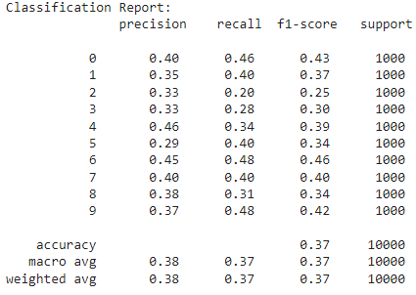
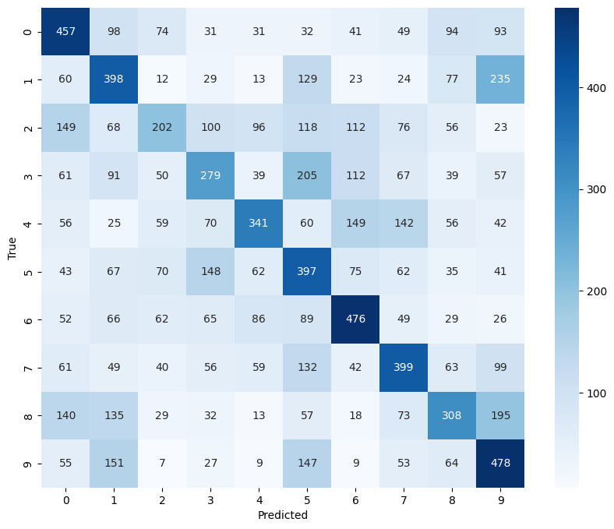
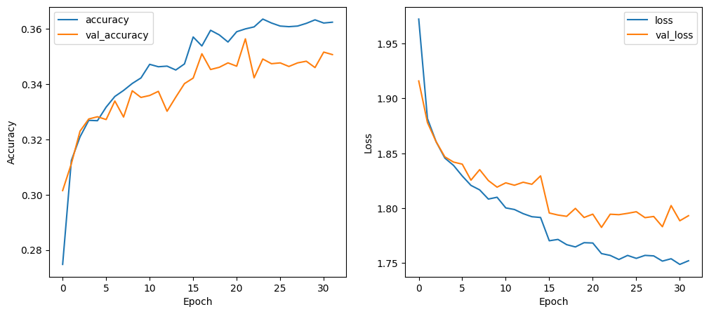
Results – transfer learning mobilenetv2(1)
Test Accuracy: 0.27 → 0.37
Val Accuracy: 0.30 → 0.346
Test Precision: 0.64
Test Recall: 0.11
Test AUC: 0.81
Test F1 score: 0.20

Slide 29
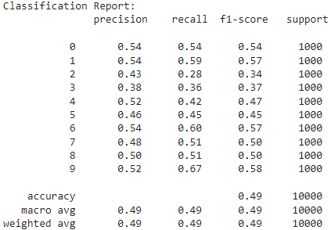
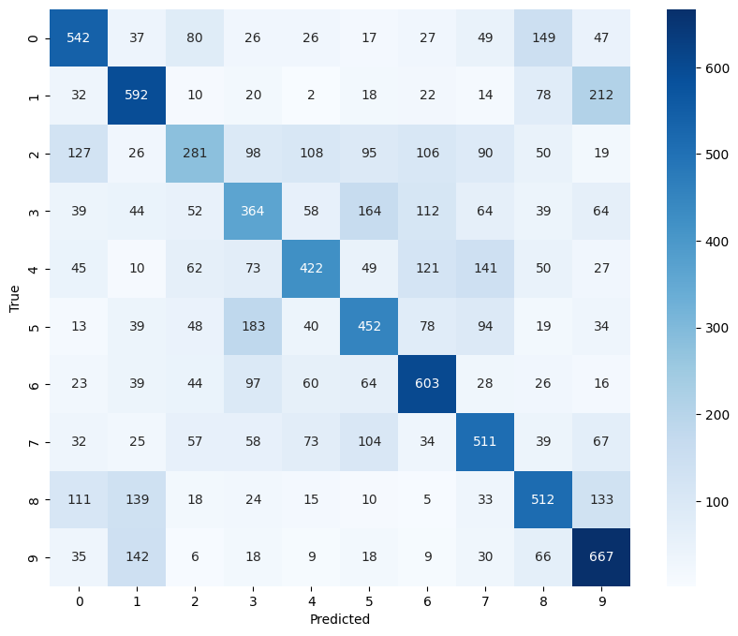
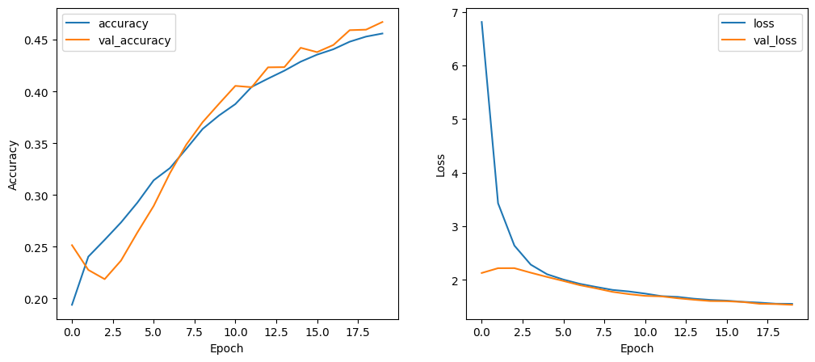
Results – transfer learning mobilenetv2(2)
Test Accuracy: 0.19→0.49
Val Accuracy: 0.25 → 0.46
Test Precision: 0.68
Test Recall: 0.29
Test AUC: 0.87
Test F1 score: 0.41

Slide 30
RESULTS – TRANSFER LEARNING – Inception_V3
Data Preprocessing:
Normalize pixel values to the range [0, 1].
Convert labels to one-hot encoding.
Model Architecture:
Base model: InceptionV3 (pre-trained on ImageNet, layers frozen).
Add global average pooling, two dense layers (256 and 128 units), and a softmax output layer (10 classes).
Data Augmentation:
Rotation range: 15 degrees.
Width and height shift range: 0.1.
Horizontal flip.
Training and Evaluation:Cross-validation: 5-fold.

Slide 31
RESULTS – TRANSFER LEARNING – Inception_V3
Training:
10 epochs with early stopping, model checkpointing, and learning rate reduction on plateau.
Evaluation:
Accuracy, Precision, Recall, AUC, F1 Score, Classification Report, Confusion Matrix.
Fine-Tuning:
Unfreeze top 10 layers of InceptionV3.
Recompile model with a lower learning rate.
Train for 10 additional epochs with the same callbacks.

Slide 32
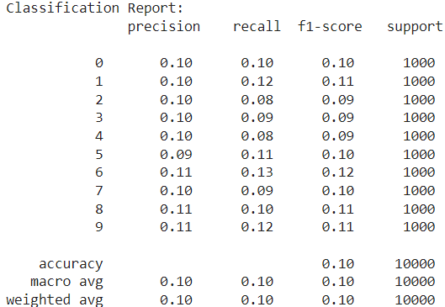
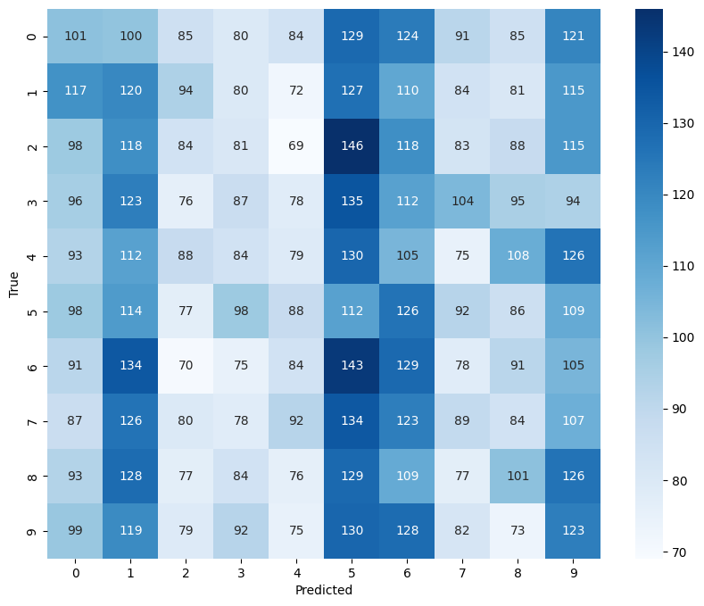
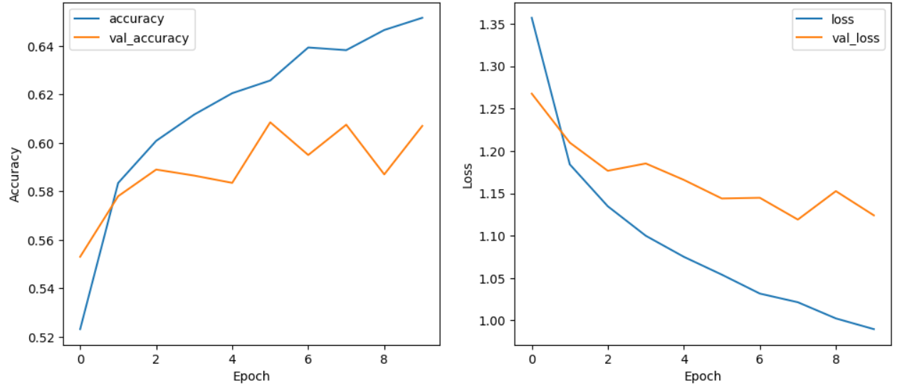
RESULTS – TRANSFER LEARNING – Inception_V3(1)
Test accuracy: 0.52 → 0.63
Val Accuracy: 0.55 → 0.60
Test precision: 0.73
Test recall: 0.51
Test AUC: 0.94
Test F1 score: 0.61

Slide 33
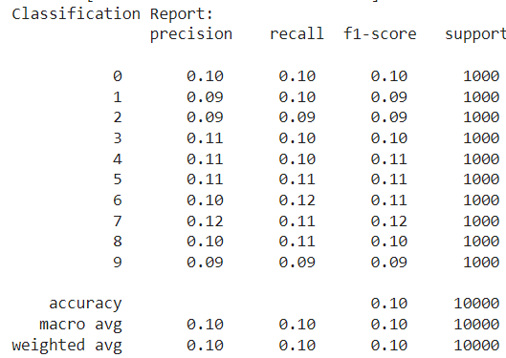
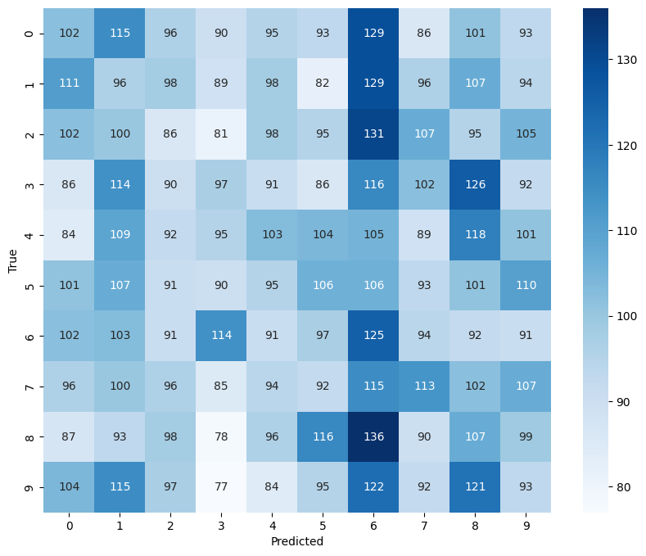
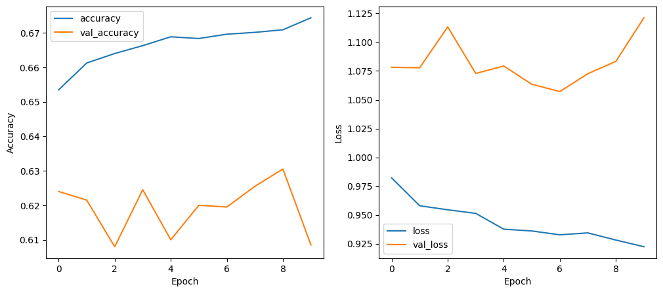
RESULTS – TRANSFER LEARNING – Inception_V3(2)
Test accuracy: 0.65 → 0.67
Val Accuracy: 0.62 → 0.61
Test precision: 0.75
Test recall: 0.54
Test AUC: 0.94
Test F1 score: 0.63

Slide 34
RESULTS – TRANSFER LEARNING MODELS WITH LOW PERFORMANCE
EfficientB0 (Test Accuracy 0.11, Test Precision 0.0, Test Recall 0.0, Test AUC 0.56, Test F1 score 0.0)

Slide 35
Justification of the Model finally used
For our image recognition project, we choose Simple CNN as the winning model as it has the best metrics.
Simple CNN:
Test Accuracy: 0.77
Test Precision: 0.82
Test Recall: 0.72
Test AUC: 0.97
Test F1 Score: 0.77

Slide 36
THANK YOU

